Slide 1
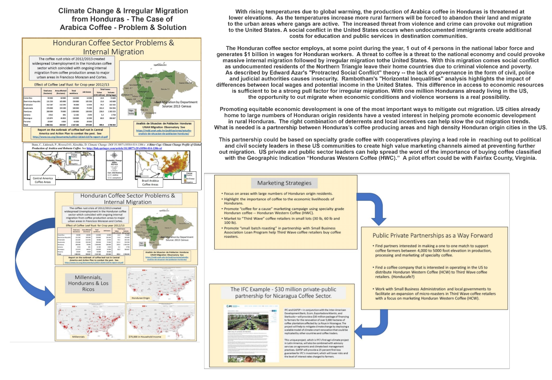
Climate Change
& Rising Temperatures
Makes Lower Elevation
Coffee Production
Unprofitable.
Resulting Poverty Provokes Rural to Urban Migration – Followed by Irregular Migration to U.S.
Partnerships to Increase the Value of Arabica Coffee can help finance crop differentiation to mitigate out migration.

