Slide 1
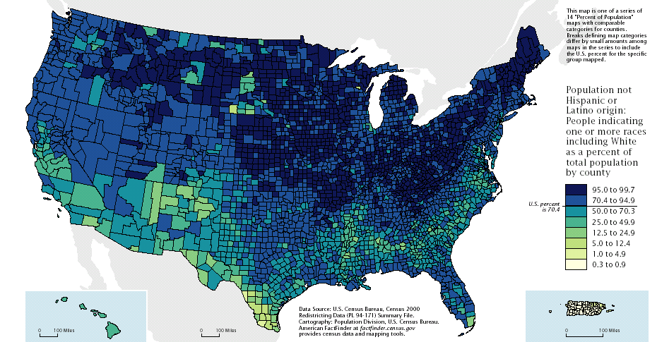
“Mi Querido Pais”
Forging a New America in the 21st Century

Slide 2
Mi Querido Pais Program
Opportunity: Radical Demographic Change in America means increased diversity and an opportunity to become a stronger nation.
Mi Querido Pais Program - 5 year, $50 million program to build linkages between U.S. and Latin American communities, promote social and economic initiatives, bridge the North/South cultural gap, and generate over $250 million in private financing for community-led development initiatives in Latin America.
Notes:
Oppportunity: Of the challenges faced by the United States, few are more daunting than the need to prepare for radical change in the demographic make-up of our country in this generation. This paper proposes a program, “Mi Querido Pais”, aimed at 1) encouraging faster economic, social and cultural assimilation of Hispanics in the U.S, and the overall growth of our nation’s social capital, 2) improving U.S. cultural understanding and tolerance of significantly increasing Hispanic populations, and 3) providing significant increases in privately generated development assistance financing for Latin American communities. This 5 year, $50 million program will link U.S. and Latin American communities in social and economic initiatives, promote activities to bridge the North/South cultural gap and generate over $250 million in private financing for community-led development initiatives in Latin America (see attached Logical Framework).
Social Capital - a set of informal values or norms shared among members of a group that permits them to cooperate with one another. The norms that produce social capital must include truth-telling, meeting obligations and reciprocity. Transaction Costs of group activities are reduced as the need for monitoring, contracting, adjudicating and enforcing formal agreements diminishes. Social capital can facilitate a higher degree of innovation and group adaptation, allow different groups to band together within a complex society to defend their interests and forms the basis for a healthy civil society (the group that falls between family and state).

Slide 3
Anglo Population Declines as Percentage of Total Population
U.S. Population by Race
Millions

Slide 4
Challenges
Assimilation - Slower rate of assimilation by Hispanics than previous immigrant waves. Spanish remains the predominant language (preferred or equal to English in 70 percent of Hispanic households).
Poverty - Hispanics are more likely to be unemployed than non-Hispanic whites and poverty is three times more likely in Hispanic households than among non-Hispanic white households.
Low Voter Registration - Hispanics have lowest rate of voter registration of any ethnic group. 100 million citizens voted in the 2000 November election --- Hispanics were 7% of the total vote yet they represent 12.5% of the total US population. In comparison, blacks make up 12.1% of the population and 10% of the electorate.
Illegal Immigration - primarily from Latin America.

Slide 5
Illegal Immigration
Where do they come from?
Illegal immigrants to the US come primarily from Latin America & the Caribbean -- 88%.
Top 20 source countries include 14 Latin American & Caribbean countries.
A majority of the U.S. illegal immigrant population, 63%, came from Mexico, the INS said. The countries with the next highest shares were El Salvador, Guatemala, Canada, Haiti, Philippines and Honduras.
Carib.
Central
America
Mexico
Source: 1997 INS Report
Notes:
Illegal immigration has apparently increased dramatically during the 1990s. Senator Robert Byrd stated recently that “... illegal immigration jumped from an estimated 5 million in 1986 to somewhere between 7 million to 13 million illegals today.”
These undocumented workers are linked to the immigrant community in the United States and there seems to be a sensitivity in the Congress that this is a political issue. and immigration is an important issue to them (one which could influence how they vote, which party they support, etc.).
Senate Majority Leader Daschle’s spokeperson stated this week that the Senator believes there is bipartisan support for a broader legalization program.
The United States will be much more diverse and potentially richer if we can ensure inclusion for all citizens in the mainstream of our society. Currently Hispanics are more likely to be unemployed than non-Hispanic whites, poverty is three times more likely in Hispanic households than among non-Hispanic white households, and Spanish remains the predominant language (preferred or equal to English in 70 percent of Hispanic households). We must develop and implement programs to increase our nation’s social capital, ensure faster economic, social and cultural assimilation of Hispanics and establish mechanisms for dialogue and consensus. At the same time, we need to find ways to help Latin American communities develop their economies to relieve the pressure for out migration (a 1997 INS study found that 80 percent of illegal immigration to the U.S. originates from Latin America and the Caribbean

Slide 6
U.S. Immigration & Naturalization Service
Funding Increases vs Illegal Immigration Levels
Notes:
Washington Post, 3/18/2001, --- “... the number of undocumented immigrants in the United States appears to be far higher than the 6 million the government has estimated ---there is growing consensus that the number could be at least 50 percent higher than the official estimate … it could range from 9 million to 11 million or higher.”

Slide 7
3 Key Areas
Hispanic Assimilation in the U.S. Population
Cultural Understanding and Tolerance
Latin American Development
Notes:
Assimilation - 1) Increase the number of Hispanics with formal access to the banking sector (checking account, credit card, home loan, etc.); and 2) Promote the formation and development of country specific Hispanic groups aimed at resolving problems related to living and working in the United States, connecting them back to their countries-of-origin, and focusing on local social and community issues.
Cultural Understanding - 1) Identify and promote the development of organizations already involved in bridging the cultural and economic gap between the U.S. and Latin America (church mission groups, non-profits, NGOs, State International Development Offices, etc.); 2) Support specific initiatives aimed at leveraging an expansion of ongoing trans-cultural activities and/or developing new programs (find ways to bring diverse groups together in strategic alliances to address common issues); 3) Target high density and rapidly emerging Hispanic population areas for special cultural programs aimed at identifying and addressing local issues, establishing mechanisms for dialogue and providing support for conflict resolution.
Latin America Development - 1) Increase economic multiplier effect of remittances by lowering transaction costs and establishing “Development Fund” mechanism to support social and economic initiatives in countries to which funds are remitted; 2) Create farm-to-market links via supermarket chains with a tie-in to Hispanic communities in the United States (online or telemarketing remittance shopping service);and 3) Promote activities to increase cultural flow of “American” values - participatory & democratic mechanisms for setting development priorities, allocating funding and implementing initiatives combined with transparency, accountability and rule of law.

Slide 8
Building Blocks
Remittances - $20 billion a year - lower the transaction costs and channel some resources toward development
Home Town Associations - immigrant groups transferring U.S. values to Latin America

Slide 9
Remittances - Mexico & 11 other LAC Countries
Potential multiplier effect on GDP, consumption and investment is enormous
Latin America - remittances matter!
Inter-American Development Bank (BID) sponsored a conference in May 2001, “Remittances as a Development Tool: A Regional Conference”.
Mexico
$6,795
11 LAC
Countries
$10,652

Slide 10
Remittances from US to Latin America
1999
Mexico - $6.8 billion
Brazil - $1.9 billion
D.R. - $1.8 billion
El Salvador - $ 1.6 billion
Ecuador - $1.3 billion
Peru - $819 million
Cuba - $800 million
Jamaica - $$781 million
Haiti - $720 million
Colombia - $612 million
Guatemala - $535 million
Honduras - $368 million
Nicaragua - $345 million
Notes:
Honduras - $368
Jamaica - $781
Guatemala - $535
El Salvador - $1,580
Peru - $819
Ecuador - $1,247
Colombia - $612
Haiti - $720
Brazil - $1,898
Dominican Republic - $1,747
Nicaragua - $345
**Cuba - $800 estimate & not included
Total $10,652 w/o Cuba.

Slide 11
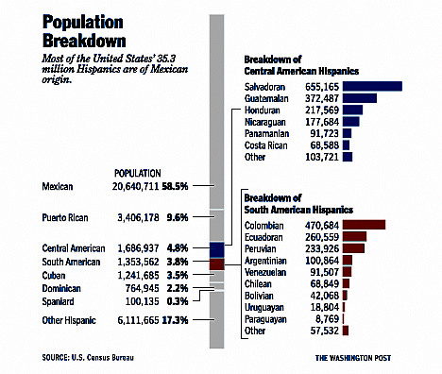
Hispanic Population Breakdown
Notes:
Hispanic origin population is 35.3 million out of a total US population of 281 million- 285 million ---- 12.5 percent of the population. But this changes when you look at the top five states hispanic population States.

Slide 12
Assimilation & Social Capital are increasing in some areas.
Hispanic Organizations - Home Town Associations
Social Capital = Trust
    Social capital is a set of informal values or norms shared among members of a group that permits them to cooperate with one another.
    Social capital can facilitate a higher degree of innovation and group adaptation, allow different groups to band together within a complex society.
    Social capital forms the basis for a healthy civil society (the group that falls between family and state).
Notes:
The norms that produce social capital must include truth-telling, meeting obligations and reciprocity. “Transaction Costs” of group activities are reduced as the need for monitoring, contracting, adjudicating and enforcing formal agreements diminishes.

Slide 13
Linkages are happening on an adhoc basis:
Anglo/Hispanic & U.S./Latin America
International Grants by Private Foundations to Latin America have increased by 100% during 1994 - 1998.
Religious Organizations and civic groups have extensive missions in Latin America (ex. “The Honduras Mission”).
Corporate Foundations are increasing their assistance to key countries in Latin America (ex. American Airlines - Mexico Paisano Community Grants).
State and Municipal Development Authorities are increasingly reaching out to export markets for new areas of growth.

Slide 14
There are some Latin American Social and Economic Development initiatives related to immigrants.
Remittances - BID is looking at potential for development financing by lowering transaction costs and facilitating access by financial service providers to the Hispanic customer base in the U.S.
Development Fund - Mexico is doing it. Some discussion among donors of a model (The Americas Fund) with matching from Latin American governments, U.S., multi-lateral banks and others. Used for investment in communities in Latin America.
Marketing Initiatives - Individual & adhoc but there is potential for U.S. and Latin American communities to work together on joint marketing initiatives --- target key markets.

Slide 15
Mi Querido Pais
    Mi Querido Pais will focus on U.S. communities that have Hispanic residents originating from 9 countries in Latin America and the Caribbean.
    It will support activities modeled after Mexico’s Paisano Program and will bring U.S. government entities together (Department of State, USAID, Comptroller of the Currency, INS, Peace Corps, Americorps and others) to work with Hispanic communities, local Non-Governmental Organizations (NGOs) and Latin American governments.

Slide 16
Mi Querido Pais
Goal
Increase social & economic development in Latin America.
Purpose
Leverage new development financing -- $250 million over five years;
Strengthen Hispanic community associations and create links within U.S. communities and country of origin; and
Provide access to key U.S. markets for Latin American products.

Slide 17
Mi Querido Pais
Component Objectives
Remittance Information System established and interacting with U.S. banking sector, Hispanic communities and Latin America markets.
Community Outreach Program working to develop Hispanic grassroots organizations, address immigrant issues and link Hispanics with existing Anglo community organizations.
Development Fund established and financed with “check off” on remittance transactions, corporate and private foundation initiatives, and matching funds from U.S. and Latin American governments.
Market Promotion Program established, potential products identified and marketing initiatives planned and implemented.

Slide 18
Mi Querido Pais
Activities
Remittance Information Service market research conducted, communication strategy & outreach program designed, program initiated to reach the “unbanked”, partnerships pursued with private financial services providers.
Community Outreach Program
target areas identified, communications plan developed and launched, cultural/education program initiated to help migrants link develop and/or link with local organizations.
Development Fund
financing arrangements and legal structure decided upon, selection of board, etc.
Marketing Program
Program designed and negotiated with U.S.& Latin American partners, products identified, markets targeted and campaigns designed
Milestones
Remittance Information Service
Information system functioning, customers use system to lower transaction cost of remittances & first partnership signed with private financial services provider to reach “unbanked.”
Community Outreach Program
First new community groups formed, linkages strengthened with existing Hispanic and Anglo groups. Agreement signed for joint cooperation.
Development Fund
501c3 NGO established to manage fund, matching mechanism legally established, fund begins to operate.
Marketing Program
First marketing events held, product sales agreements executed and sale of products initiated.

Slide 19
Mi Querido Pais
Funding
Grant - $20 million
Matching Fund - $20 million
Partnership Fund - $10 million

Slide 20
The End

Slide 21
Remittances - $819 million
Total U.S. Residents of
Peruvian Descent - 233,926

Slide 22
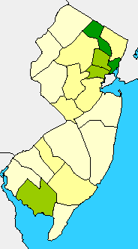
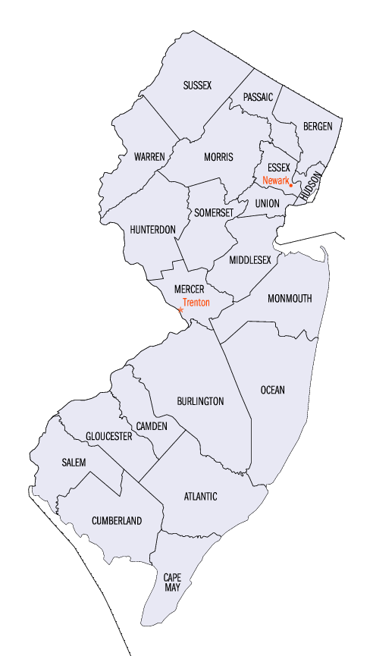
30% - 40% Hispanic
Peruvians
Passaic County - 11,543
Hudson County - 7,440
Union County - 4,336
Essex County - 3,571
Middlesex County - 3,347
Bergen County - 3,345
15% - 20% Hispanic
New Jersey

Slide 23
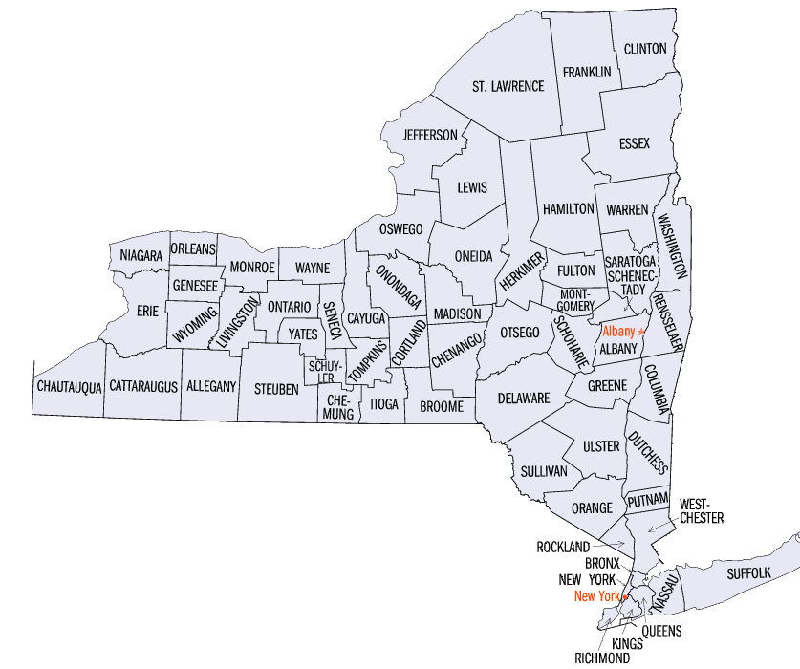
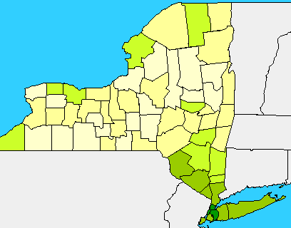
New York
25% - 48%
Hispanic
Peruvians

Slide 24
Ecuador
Total Population: 260,559
New York - 123,472
New Jersey - 45,392
Florida - 23,939
California - 18,115
Illinois - 12,060
Remittances - Ecuador - $1.3 billion

Slide 25
Colombia
Total Population: 470,684
Florida - 138,768
New York - 104,179
New Jersey - 65,075
California - 33,275
Texas - 20,404
Remittances - Colombia - $612 million

Slide 26
Dominican Republic
Total Population: 764,945
New York - 455,061
New Jersey - 102,630
Florida - 70,968
Massachusetts - 49,913
Rhode Island - 17,894
Remittances - D.R. - $1.8 billion

Slide 27
Guatemala
Total Population: 372,541
California - 143,500
New York - 29,074
Florida - 28,650
Illinois - 19,790
Texas - 18,539
Remittances - Guatemala - $535 million

Slide 28
Honduras
Total Population: 217,578
Florida - 41,229
New York - 35,135
California - 30,372
Texas - 24,179
New Jersey - 15,431
Remittances -
Honduras - $368 million

Slide 29
Nicaragua
Total Population: 177,684
Florida - 79,559
California - 51,336
New York - 8,033
Texas - 7,487
New Jersey - 4,384
DC Area - 7,235
Remittances - Nicaragua - $345 million

Slide 30
El Salvador
Total Population: 655,165
California - 272,999
Texas - 79,204
New York - 72,713
DC Area - 89,827
New Jersey - 25,230
Other - 94,491

Slide 31
Panama
Total Population: 91,723
New York - 20,055
Florida - 15,117
California - 10,688
Texas - 7,706
Georgia - 3,535
DC Area - 6,456

