Slide 1
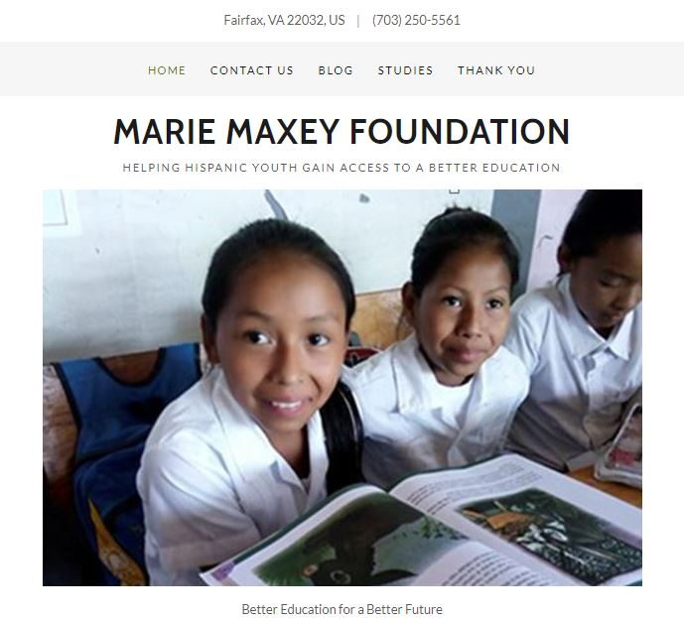
Children, Communities
& a Better Future
501c3 Non-Profit - EIN: 83-1473076
Marie Maxey Foundation
http://www.maxeys.org

Slide 2
What we believe.
All children should have access to high quality education.
Poor education outcomes is linked to expanding cycles of poverty and violence which in turn is linked to increased out migration.
Communities must come together to support better education outcomes to address poverty and violence.

Slide 3
Impact of High Quality Education
High quality education strengthens human capital and increases workforce productivity.
Greater productivity enhances Foreign Direct Investment and promotes economic development.
Increased economic development helps promotes political stability, social equity and decreased violence.
Notes:
High quality education strengthens human capital and increases workforce productivity. Research indicates that efforts to increase human capital can results in higher productivity, increased incomes and sustained economic growth. Studies worldwide have found a strong correlation between high quality education and significant economic growth. One study, for example, found that a one standard deviation in higher cognitive skills in a country’s workforce is associated with an approximately two percentage point increase in annual per capita GDP. While school enrollment has increased across Latin America, quality of education as reflected by learning outcomes has not kept pace. Student achievement on international, regional and national learning assessments is consistently lower for Latin America compared to countries with similar incomes in other parts of the world.
Greater productivity enhances Foreign Direct Investment and promotes economic development. Improving the quality and relevance of education has the potential to (1) open and expand new markets for US economic interests (an expanding middle class in Latin America will increase market demand for US products), (2) promote significant economic growth in the region, (3) provide needed skilled labor for expanding US business operations, and (4) decrease inequity, improve transparency and promote stability. A better educated Latin America populace can result in greater Foreign Direct Investment and clearly important to US foreign policy objectives.
Increased economic development helps address political instability, social inequity and increased levels of violence. Research indicates that economic growth is associated with lower levels of conflict and that policies which promote economic growth in developing countries are likely agents for conflict prevention. Increasing the quality of education results in high achievement in math and literacy which in turn supports a more productive and competitive workforce. While economic growth can promote stability and give people hope for a better future – a key fundamental ingredient is a high quality education system that provides equitable access, effective instruction and appropriate support systems to ensure high quality learning outcomes. A good education combined with economic opportunity are key -- together these factors can help reduce instability and violence while easing the pressure for out migration.
Schultz, T. W. (1961). Investment in Human Capital. The American Economic Review, 51(1), 1-17
Hanushek, E. A., & Woessmann, L. (2012). Do better schools lead to more growth? Cognitive skills, economic outcomes, and causation. Journal of economic growth, 17(4), 267-321.
Bos, M. S., Elías, A., Vegas, E., & Zoido, P. (2016a). PISA Latin America and the Caribbean: How Did the Region Perform? (Brief 1). Washington, DC: Inter-American Development Bank. Retrieved from https://publications.iadb.org/bitstream/handle/11319/7991/Latin-America-and-the-Caribbean-in-PISA-2015-How-Did-the-Region-Perform.PDF?sequence=4&isAllowed=y .
Donaubauer, J., Herzer, Dierk and Nunnenkamp, P. “Does Aid for Education Attract Foreign Investors? An Empirical Analysis for Latin America.” European Journal of Development Research (2014) 597-613 published online December 5, 2013. See https://pdfs.semanticscholar.org/b3a0/5d0089c5fcde50af9ee2ad2e68749236c0e4.pdf.
Humphreys, M., “Economics and Violent Conflict” Feb. 2003. Harvard University. See https://hhi.harvard.edu/publications/economics-and-violent-conflict.

Slide 4
It all starts in the Northern Triangle.
Poor education outcomes in the Northern Triangle and US Destination Communities.
High unemployment and hopelessness in the Northern Triangle.
Lack of private investment in the Northern Triangle.

Slide 5
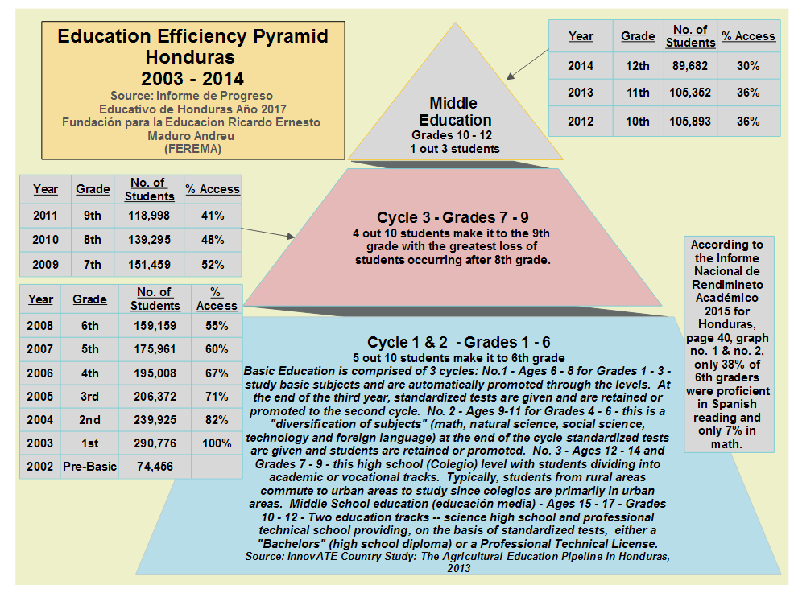
Notes:
Only half of the children in Honduran public schools make it to the 6th grade and of those only half read at grade level. A child in Honduras has approximately $645 per year invested in their public school education (1.7 million students in public schools with a national education budget of $1.1 billion). Once that same child reaches the US, the cost of his or her education goes up exponentially. We need to be strategic and make the investments needed to prevent out migration from the Northern Triangle. See https://www.maxey.info -- follow the link and scroll down to the presentation.

Slide 6
What we see.
Increasing out migration from Northern Triangle to US communities where family, friends and countrymen already reside – Washington DC Metro Area is in the top five destinations for these migrants.
Increasing costs on our education system to deal with the influx of children that need special attention to help them succeed academically and in society at large.
Lack of a coherent plan that brings the entire community together to support education and mentoring of youth from the Northern Triangle.

Slide 7
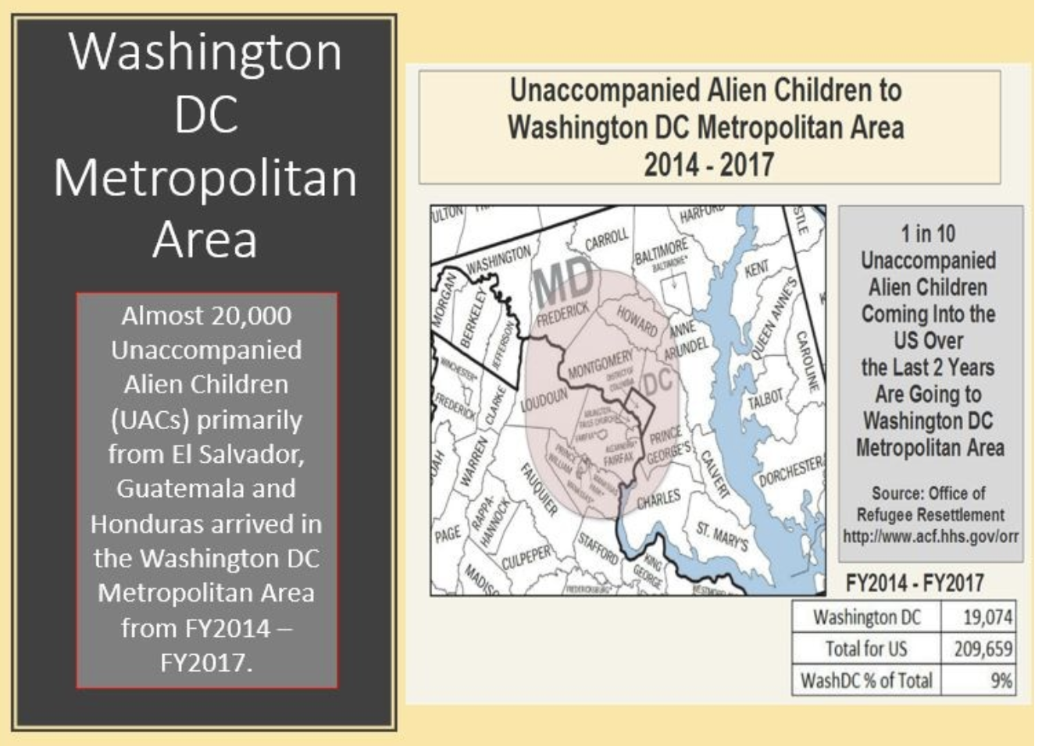
Notes:
A recent report by Latin American Public Opinion Project (LAPOP) and the Inter-American Dialogue -- "Beneath the Violence" -- indicates that fear of crime causes a significant number of citizens in the Northern Triangle (El Salvador, Honduras and Guatemala) to change their daily activities. A survey comprised of 9,300 in-person interviews in Central America as part of the 2016/2017 AmericasBarometer, found that more than 50 percent of the population has avoided leaving their home to make purchases for fear of crime. Over 60 percent has kept children at home, more than 40 percent have avoided public transportation, and almost one in three has considered emigrating due to insecurity. The study indicates that crime victimization and avoidance behavior may be useful indicators for identifying populations most at risk to migrate.
Clearly, the decision to emigrate is caused by a complex set of factors and the movement of children through dangerous migration routes to the US has to be a difficult, almost desperate decision by parents and loved ones. Making Northern Triangle communities safe while encouraging local economic growth, job creation and increased livelihoods is needed to stem the flow of migrants to the US. Physical and natural barriers will not be sufficient to stop the residents from the Northern Triangle to emigrate to US communities. We need to help people to have hope for a better future -- a future in which family members can return home from the US to help build a stronger, more prosperous country.
The consequences of the continued emigration to the US, especially of children under the age of 17 -- Unaccompanied Alien Children (UACs) -- create a significant economic burden on US communities that receive these children. While compassionate communities are helping address the issues faced by these children, the economic costs are high. For example, the Washington DC Metropolitan Area is one of the top destinations for UACs and over the last four years (2014 - 2017) with almost 20,000 children out of more than 200,000 Northern Triangle UACs arrivals in the US according to the Office of Refugee Resettlement at the Department of Homeland Security. That means that over the last four years, one of every ten UACs coming into the US has arrived in the Washington DC area.

Slide 8
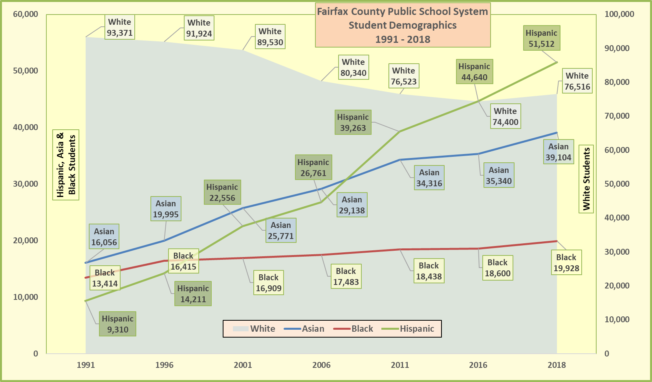
Notes:
The rise in Unaccompanied Alien Children (UAC) detainees from Central America is increasing the number of children entering public schools. According to US Census data, residents who originate from the Northern Triangle (Guatemala, El Salvador and Honduras) are found in ten US metropolitan areas. These are the same areas to which UACs are primarily being released by Customs and Border Protection according to the Office of Refugee Resettlement, Department of Homeland Security. A case study focusing on Fairfax County in Northern Virginia looked at impacts from increased Hispanic migration including UACs. According to the Fairfax County Schools Budget Committee, county revenue was insufficient to cover school budgets in 2015 and 2016 due to changing demographics. Hispanic student population has more than doubled since 2000 and now represents the second largest ethnic group (51,512 Hispanics vs 76,516 Whites).

Slide 9
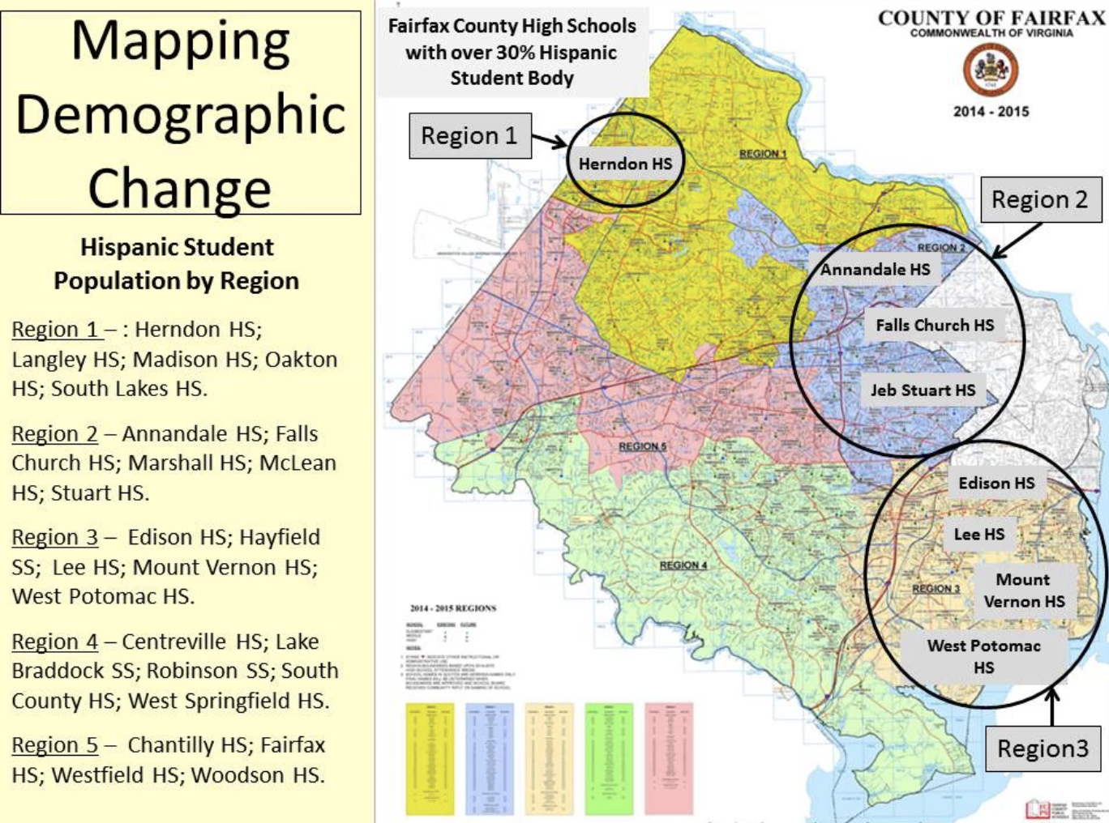
Justice High School

Slide 10
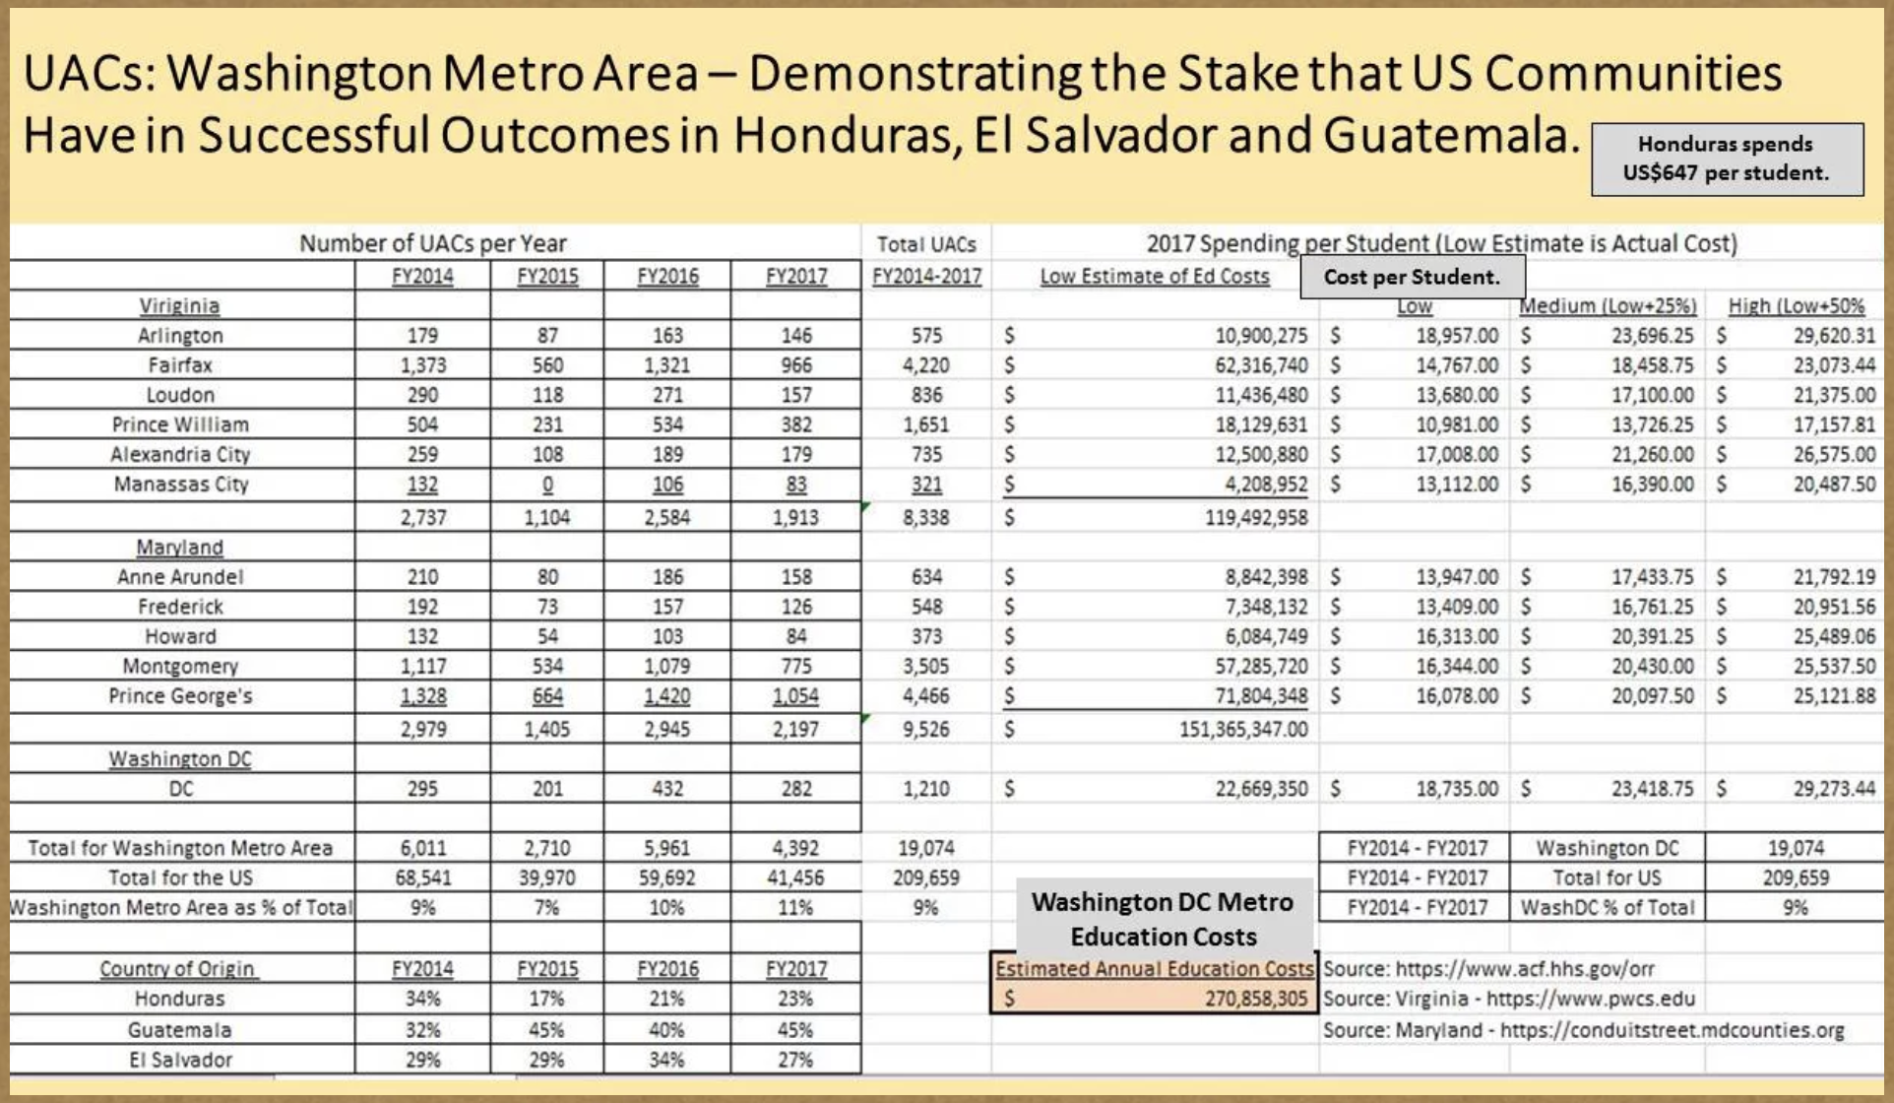

Slide 11
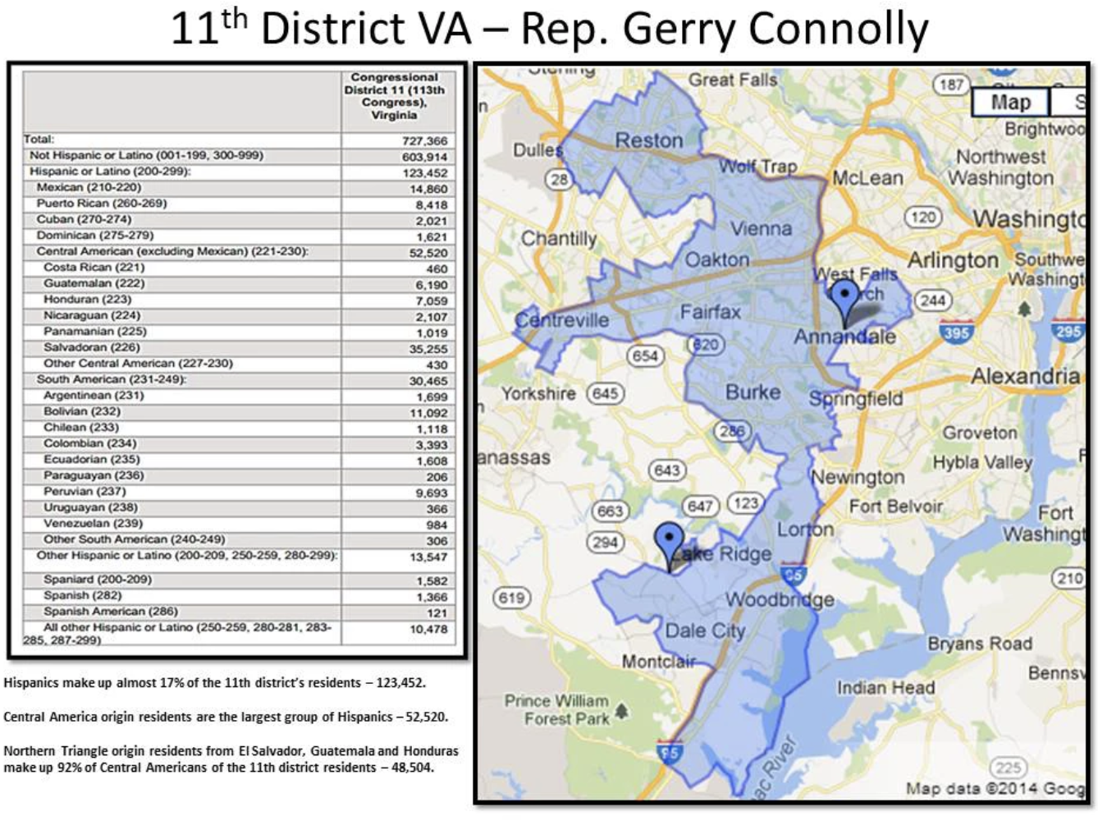
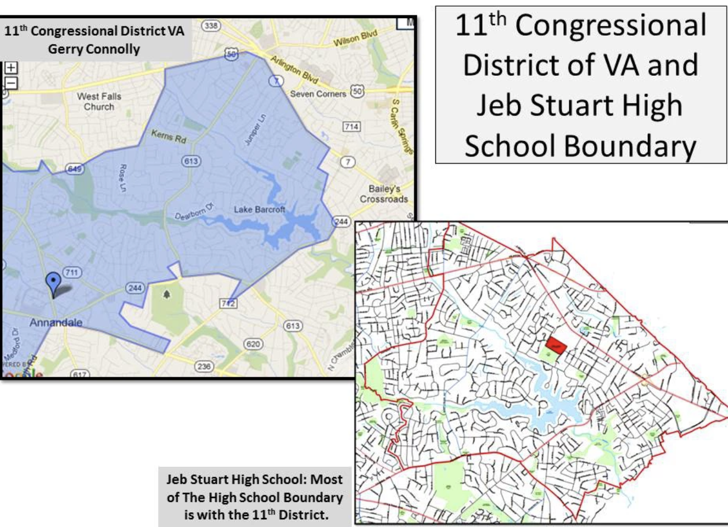
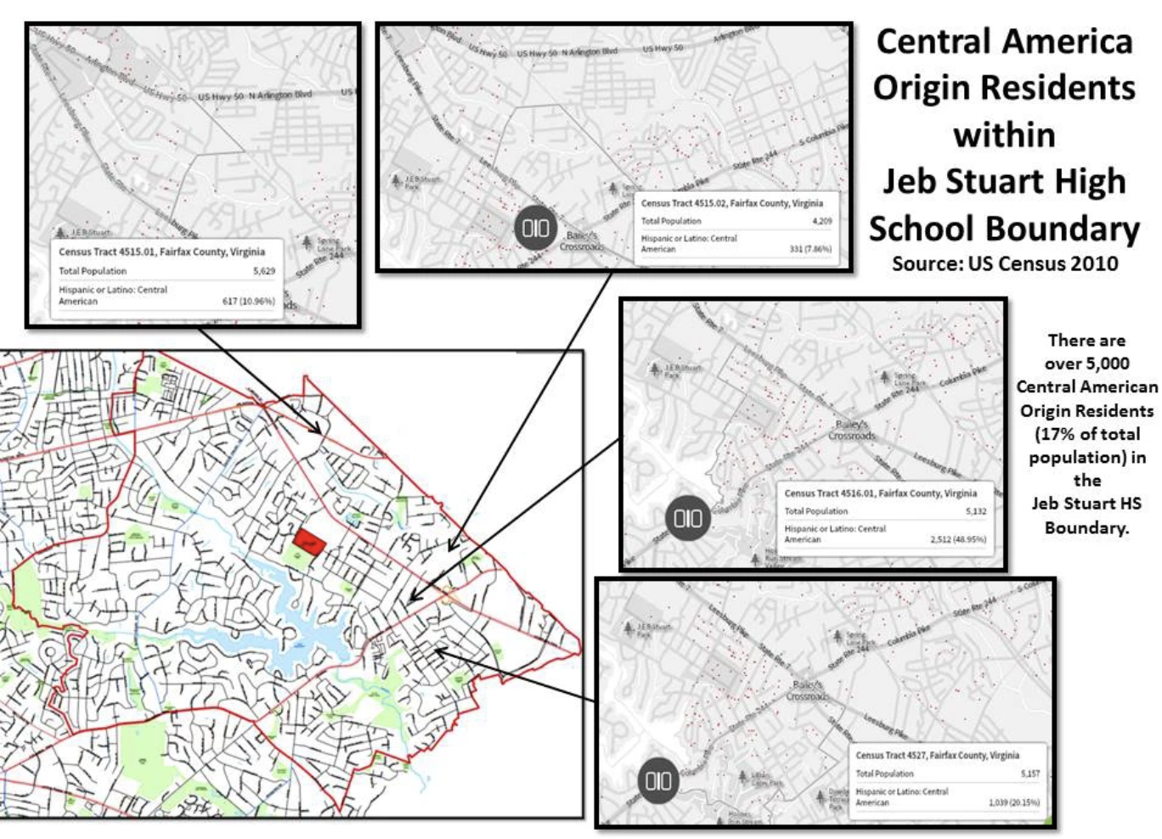
5,000 Central American Residents in Justice High School Boundary
(1 UAC per 67 Central American Origin Residents) – 75 UACs at an
additional cost of $14,767 each would add $1.1 million to education
for this school.
Justice High
School Boundary
Justice High School Boundary

Slide 12
Three Pathways Forward
Education Pathway for Hispanic Children.
Guest Worker Pathway for Migrant Adults.
Investment Pathway for Northern Triangle.

Slide 13
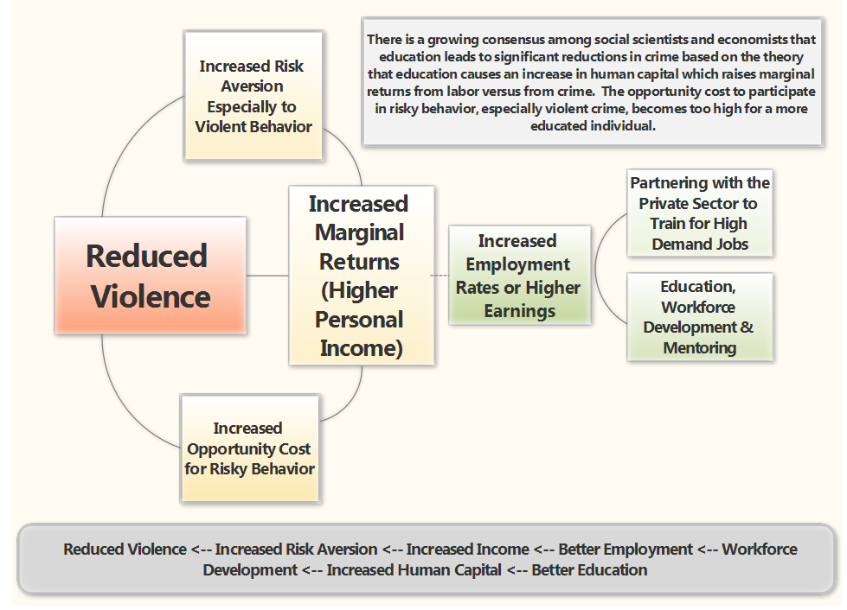

Slide 14
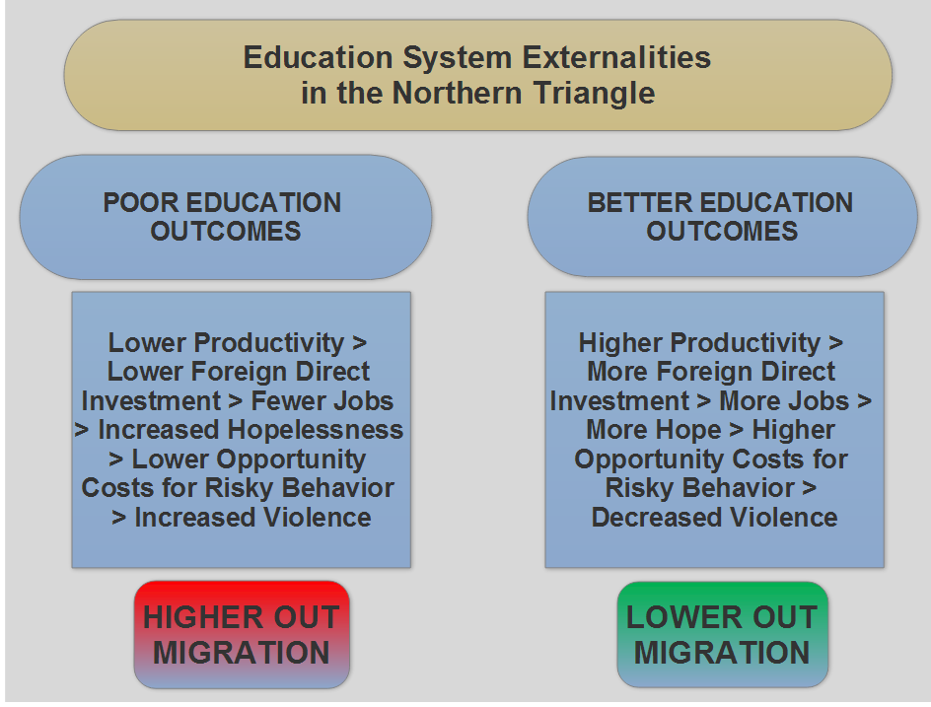

Slide 15
Education
Expanded support for education activities in the Northern Triangle.
Funding for community initiatives in the Washington DC Metro Area and other US communities impacted by Northern Triangle out migration.
Matching funding for public – private partnerships with 501c3 non-profits supporting improved education outcomes.

Slide 16
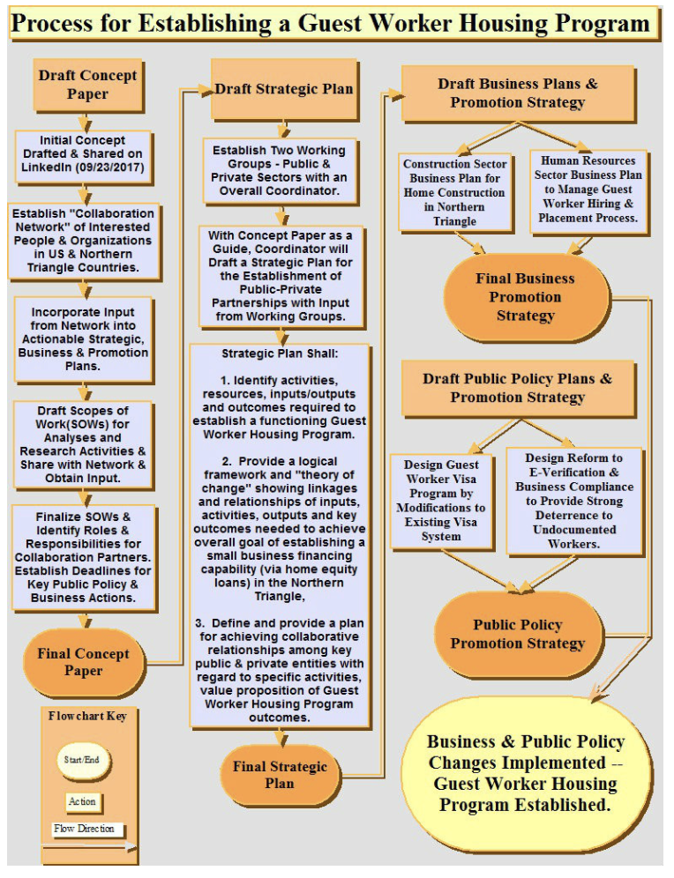
Guest Worker Program
Strengthen e-verify system to ensure that only workers with a legitimate visa are employed in the US.
Establish a Guest Worker Program to allow 3 to 4 million Northern Triangle workers work visas for 3 to 4 years.
The guest workers would contribute to a “housing” fund instead of paying FICA contribution.
Housing fund would provide approximately $25,000 for construction of a home in the guest worker’s country of origin upon their return home.

Slide 17
Investment Fund
Provide matching funding for business start up in the Northern Triangle as an option for guest worker contributions in addition to housing fund.
Promote US construction sector to initiate operations in Northern Triangle Housing sector in coordination with the housing fund (ability to offset risk of investment through Development Credit Authority and matching funds).
Review Central America Free Trade Agreement and find ways to promote US investment in areas that enhance US imports to the Northern Triangle.

Slide 18
Next Steps
Review the 2013 Border Security, Economic Opportunity and Immigration Modernization Act
Highlight the win/win aspects of this legislation.
Revive bi-partisan negotiation for immigration reform that includes border security as well as actions to mitigate the triggers of out migration from the Northern Triangle.

Slide 19
Questions

