Slide 1
Remittances to Latin
America in 2019 increased but at a slower rate of growth. Countries with higher levels of
Instability saw greater
Increases in remittances:
Venezuela, Brazil, Honduras & Nicaragua.
Remittances to Northern
Triangle represent a significant amount of GDP. Honduras and Guatemala saw an increase in growth in the amount of remittances provided in 2019.
Remittances to Venezuela grew by 28% in 2019 and represent a critical lifeline for vulnerable populations there.

Slide 2
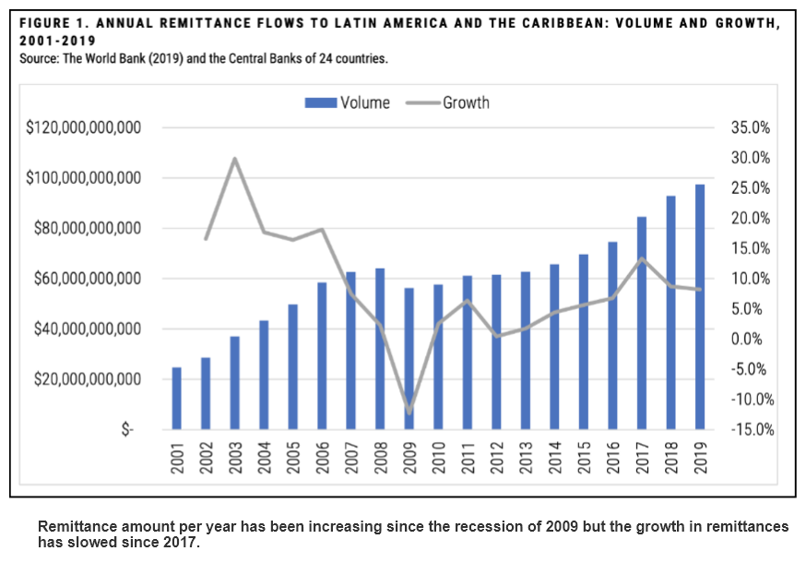
Remittances to Latin
America have been increasing since 2009 reaching $97 billion dollars in 2019. The rate of growth in remittances is decreasing overall since 2017.
Remittances to Mexico are the lion’s share of overall total at $36.1 billion. The growth in remittances was 11% in 2018 and went down to 7% in 2019.
Top six remittance receiving countries in Latin America:
(1) Mexico - $37 billion; (2) Guatemala - $10.5 billion; (3) Dominican Republic - $7.1 billion; (4) Colombia - $6.8 billion; (5) El Salvador - $5.7 billion; & (6) Honduras - $5.4 billion.

Slide 3
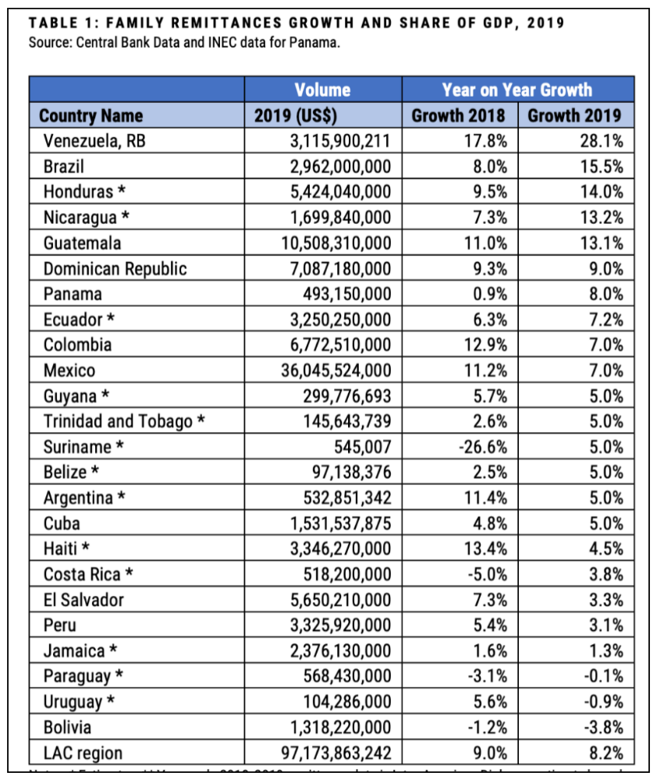
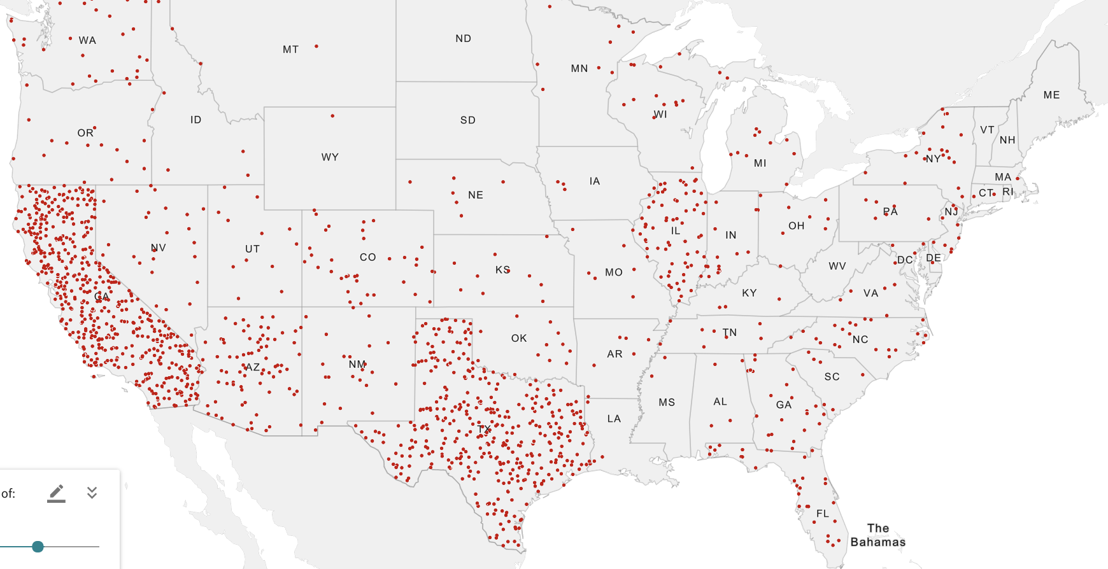
Country | Remittances in 2019 | GDP 2019 | % of GDP
Haiti | $3.4 Billion | $10.0 Billion | 34.0%
Honduras | $5.4 Billion | $24.9 Billion | 21.8%
El Salvador | $5.7 Billion | $26.0 Billion | 21.7%
Nicaragua | $1.7 Billion | $12.5 Billon | 13.6%
Guatemala | $10.5 Billion | $85.3 Billion | 12.3%
Total remittances to Latin American by immigrants amounted to $97 billion in 2019 with 37% going to Mexico. Mexican origin remittances from Florida, New York and Georgia averaged 20% higher than from Mexican origin residents in California. Remittance amounts are higher and frequency is greater reflecting fear of deportation. Overall growth is dropping but remittance amounts as share of income increased to over 20%.
Mexican Origin Residents
In US – 36.1 million
New York
477,194
Georgia
561,710
Florida – 713,518

Slide 4
Saliendo Adelante Report
Findings & Recommendations
(http://www.creativeassociatesinternational.com/wp-content/uploads/2019/09/Migration-Study-Brief.pdf)
1. Migration is highly localized & requires strong focus on high-migration areas.
2. Economics are driving migration and economic development must be a key goal of mitigation programs.
3. Youth are most likely to migrate – meeting their needs is key to stopping out migration.
4.Victimization is a factor in migration & promoting local rule of law and security is important to address victimization of all types.

Slide 5
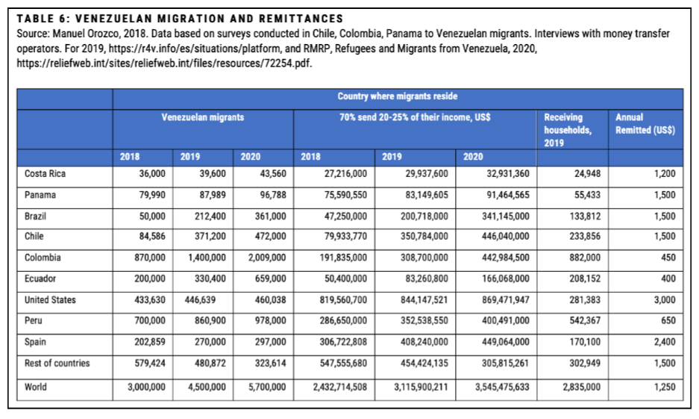
Venezuela has seen
a major out migration
of citizens to Latin
America and the US.
By 2020, it is projected that 5.7 million Venezuelans will be living outside the country.
With 70% of immigrants sending up to 25% of their income, there is a tremendous surge of remittances to Venezuela. Total remittances are up 28.1% for 2019. Immigrants in the US are sending the most remittances per individual with $3,000 annually.

